Slide 1

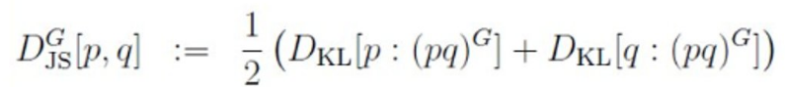
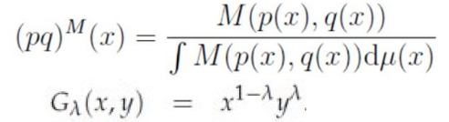
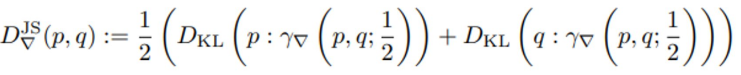
Geometric Jensen-Shannon divergences: Two meanings
Ordinary
Jensen-Shannon divergence
Replace arithmetic by abstract mean in the JSD: M-JSD
View JSD as a contrast divergence, a geometric function on the product manifold MxM using a ∇-geodesic: ∇-JSD
①
Mixture wrt
a mean M
Geometric mean M=G
②
Notes:
Two definitions of the geometric Jensen-Shannon divergences (G-JSD):
① Use M-statistical mixtures. Merit is to obtain closed-form formula for multivariate normal with M=geometric mean:
https://www.mdpi.com/1099-4300/21/5/485
② Define statistical divergence geometrically as a function on the product manifold. Then replace abstract mean by midpoint on a geodesic:
https://link.springer.com/chapter/10.1007/978-3-031-38271-0_15
Video: https://www.youtube.com/watch?v=m-mElw8nRPM

Slide 2
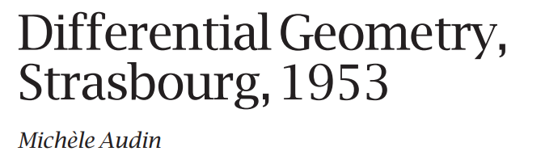
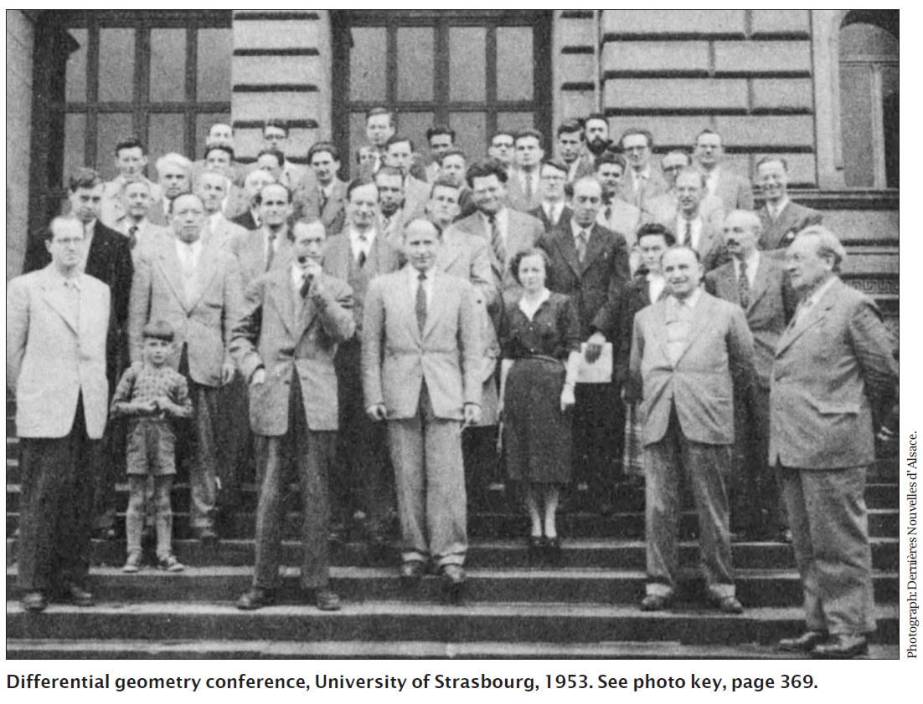
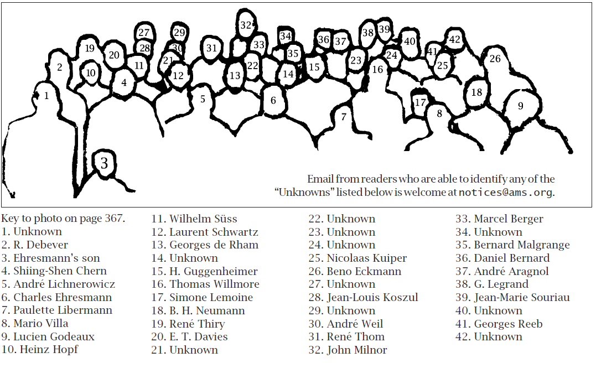
Notes:
So many famous geometers gathered in Strasbourg (France) in 1953!
Three profiles detailed by Michele Audin in AMS Notices (March 2008):
PDF: https://www.ams.org/notices/200803/tx080300366p.pdf

Slide 3
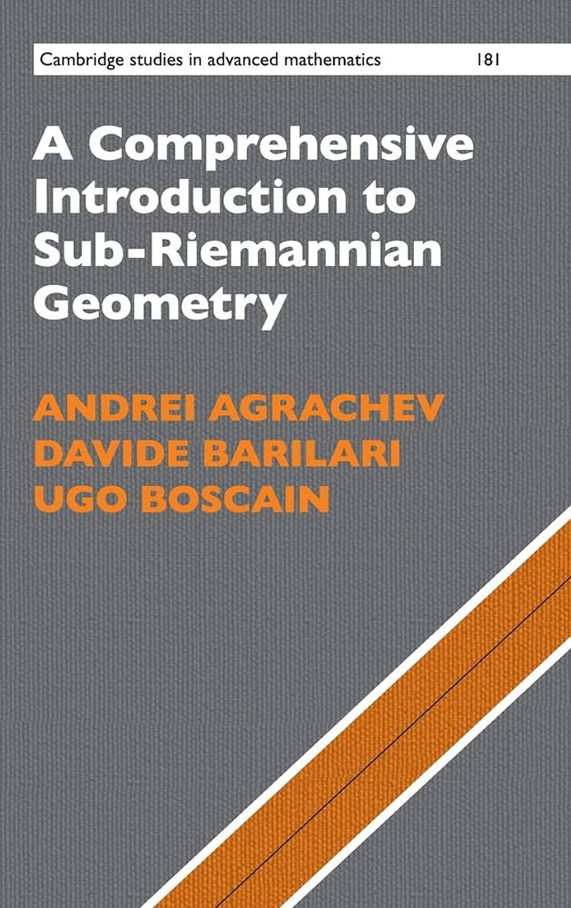


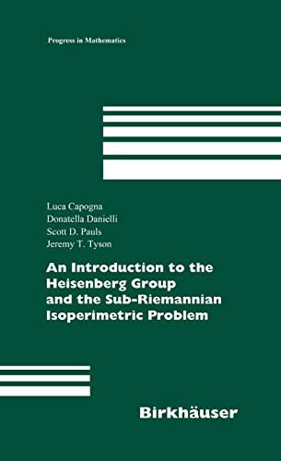

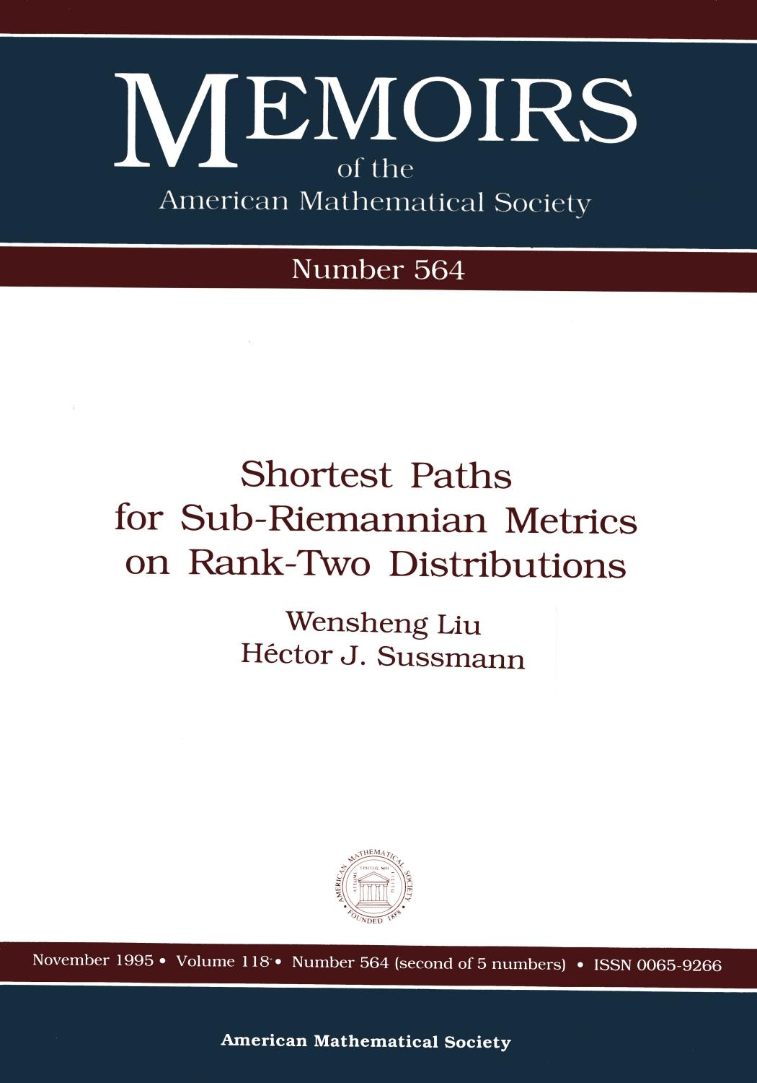

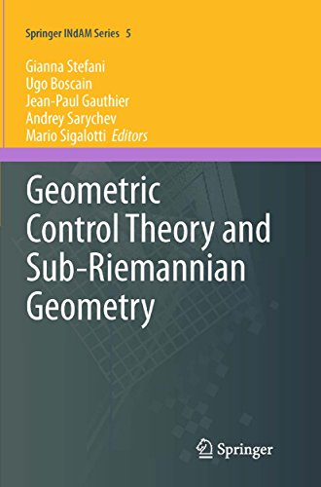
Notes:
Sub-Riemannian manifolds M generalize Riemannian manifolds by defining intrinsic metrics called the metrics of Carnot–Carathéodory.
Manifolds M are equipped with completely non-integrable horizontal distributions.
Lecture notes on sub-Riemannian geometry by Enrico Le Donne
https://cvgmt.sns.it/media/doc/paper/5339/sub-Riem_notes.pdf
https://en.wikipedia.org/wiki/Sub-Riemannian_manifold

Slide 4
The many A’s of AI!
Artificial Intelligence
Amplification
Augmented
Auxiliary
Abstract
Advanced
Autonomous
Automatic
Another
…

Slide 5
Schedule 2024
Maiken March 23rd-April 6
14-17 mai 2024 Entropies et divergences : modélisation . statistique . algorithmique - Sciencesconf.org
GdR IASIS (ex-ISIS) 19, 20, 24 ou 25. Juin
15-19 July 2024 https://www.ecm2024sevilla.com/
https://site.unibo.it/calista/en
Mines ParisTech, PARIS, 2nd to 4th September 2024
Carnot Lille 11-13 September
Notes:
Mesures informationnelles classiques, quantiques et généralisations

Slide 6
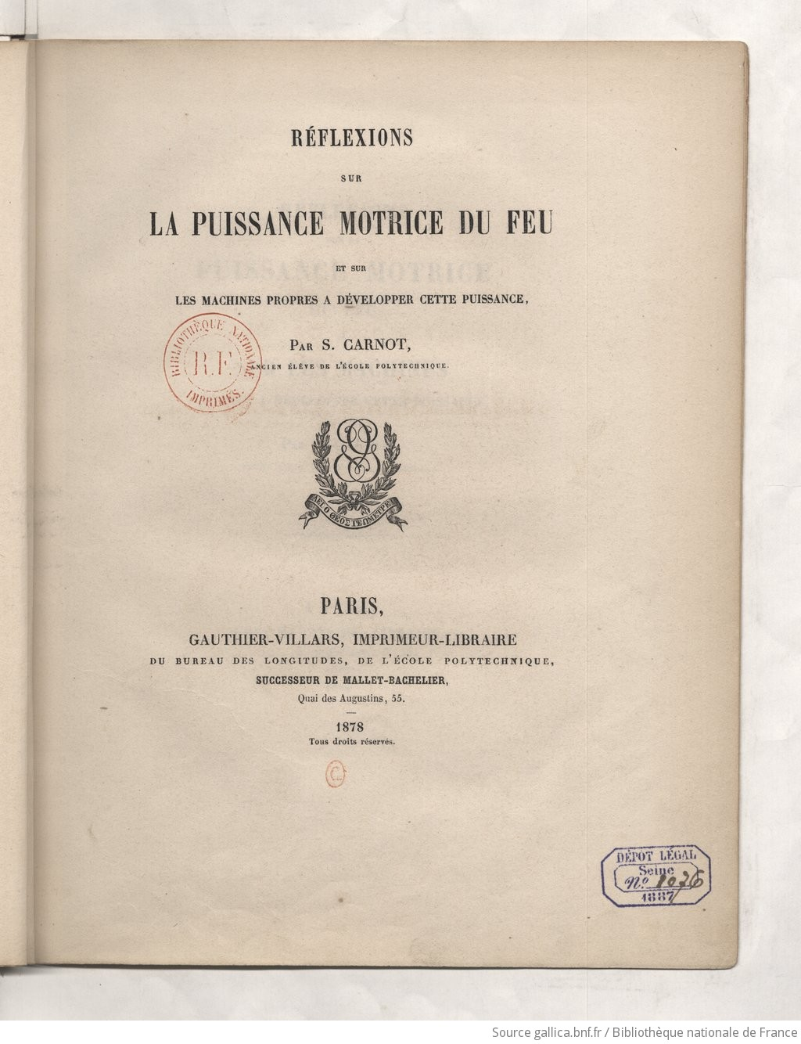
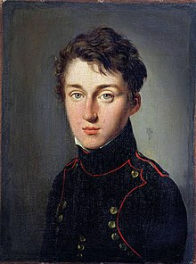
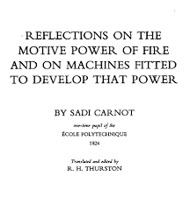
1824-2024: 200 YEARS BIRTHDAY OF THERMODYNAMICS
Father of Thermodynamics
(Nicolas Léonard)
Sadi Carnot
1796-1832
(aged 36)
Notes:
2024 is the bicentennial celebration of the birthday of thermodynamics by Sadi Carnot who passed away from cholera at 36 years old.
His unique 1824 French book is the founding work of thermodynamics which formulated the second law of thermodynamics and was later translated in English as “Reflections on the Motive Power of Fire”
Timeline of thermodynamics
https://en.wikipedia.org/wiki/Timeline_of_thermodynamics
2024 conference in homage of Carnot:
https://carnotlille2024.sciencesconf.org/
https://twitter.com/FrnkNlsn/status/1526065109843714053
1824-2024 : 200 YEARS BIRTHDAY OF THERMODYNAMICS INVENTION by SADI CARNOT Celebration of 200 years since the publication of Sadi Carnot's Réflexions sur la puissance motrice du Feu, 1824–2024 CARNOT LILLE 2024:
Father of Thermodynamics
https://en.wikipedia.org/wiki/Nicolas_L%C3%A9onard_Sadi_Carnot
https://carnotlille2024.sciencesconf.org/
https://www.youtube.com/watch?v=ldGs2lgW_tM

Slide 7
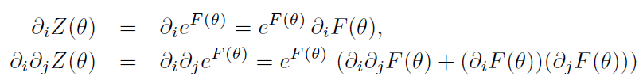
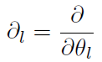
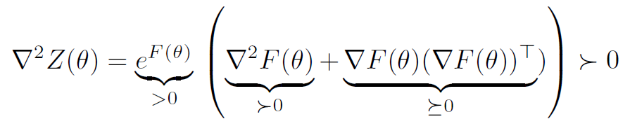

Log-convex functions are convex
Definition: A function Z is log-convex if F=log Z is convex
Proposition: Strictly log-convex functions are strictly convex
Proof: Let Z=exp(F) with ∇² F positive-definite (ie, strictly convex F)
In matrix form:
since outer-product of vectors are positive semi-definite:
Thus both the partition function and the cumulant function of an exponential family are convex and define Bregman and Jensen divergences with corresponding statistical divergences
with

Slide 8

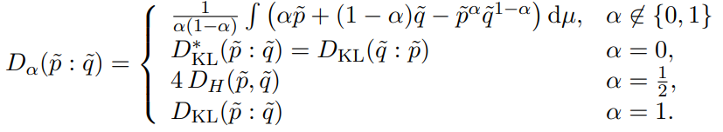
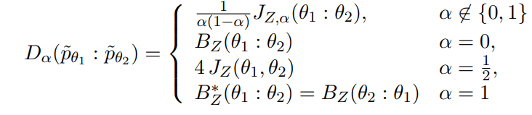
𝛼-divergences between unnormalized densities of an exponential family
Partition function Z of an exponential family is log-convex and hence convex, define Bregman and skewed Jensen divergences with corresponding statistical divergences
Unnormalized densities of an exponential family:
Notes:
Well-known that Kullback-Leibler divergence between exponential family densities amount to a reverse Bregman divergence induced by the cumulant function.
KLD between unnormalized densities amount to a reverse Bregman divergence induced by the partition function which is log-convex and hence convex.
👉https://arxiv.org/abs/2312.12849

Slide 9
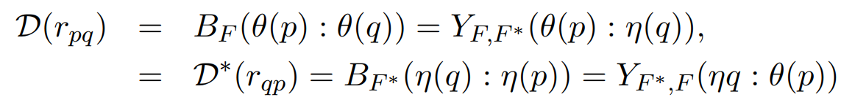
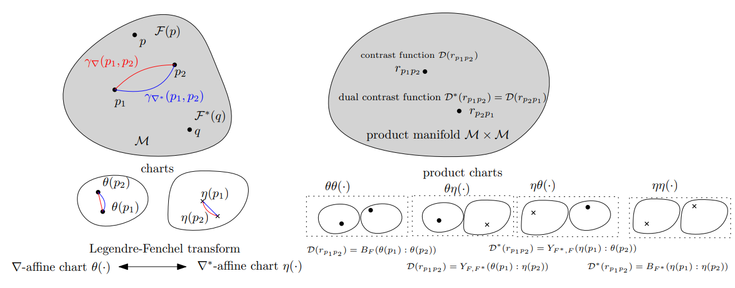
Dually flat divergence expressed in coordinate charts as dual Bregman or Fenchel-Young divergences

Slide 10
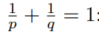
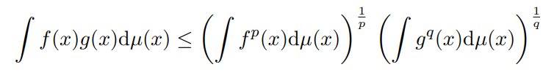



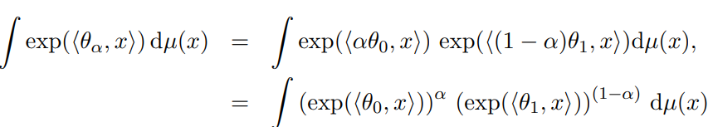



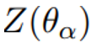
Exponential families and Hölder inequality (1/3)
Hölder inequality for positive functions and
Hölder inequality: prove that natural parameter space is convex:
Prove that for
=
Notes:
Hölder inequality is used to prove that the natural parameter space of exponential families is convex:
Choice of Hölder conjugate exponents and positive powered partition functions.
http://arxiv.org/abs/2312.12849

Slide 11
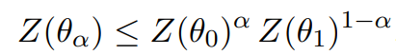
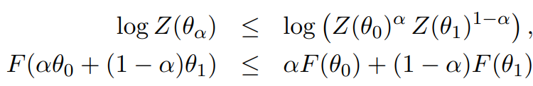
Exponential families and Hölder inequality (2/3)
=
In 1/3, proved
That is in compact form:
We recognize (A,G)-comparative complexity wrt to arithmetic and geometric means. Hence, partition function Z is log-convex
Since the logarithm is a strictly increasing function, we further have:
That is, the cumulant function F=log Z is convex
Notes:
(2/3) Thread on exponential families & Hölder inequality
Hölder inequality is used to prove that the partition function Z is log-convex.
By taking the logarithm of the log-convex inequality, we get that the cumulant function F=log Z is convex
http://arxiv.org/abs/2312.12849
https://twitter.com/FrnkNlsn/status/1740200121206534303

Slide 12
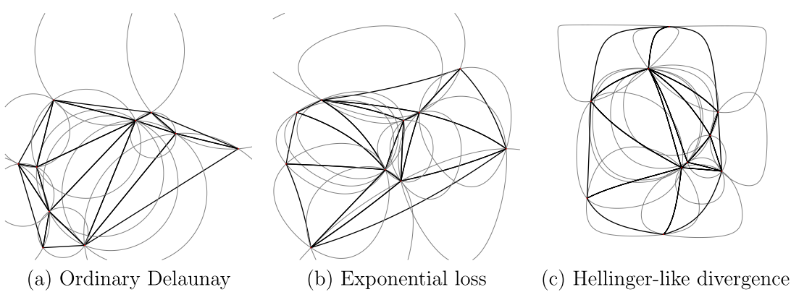
Bregman Delaunay triangulations/complexes
… satisfy the Bregman empty sphere property

Slide 13
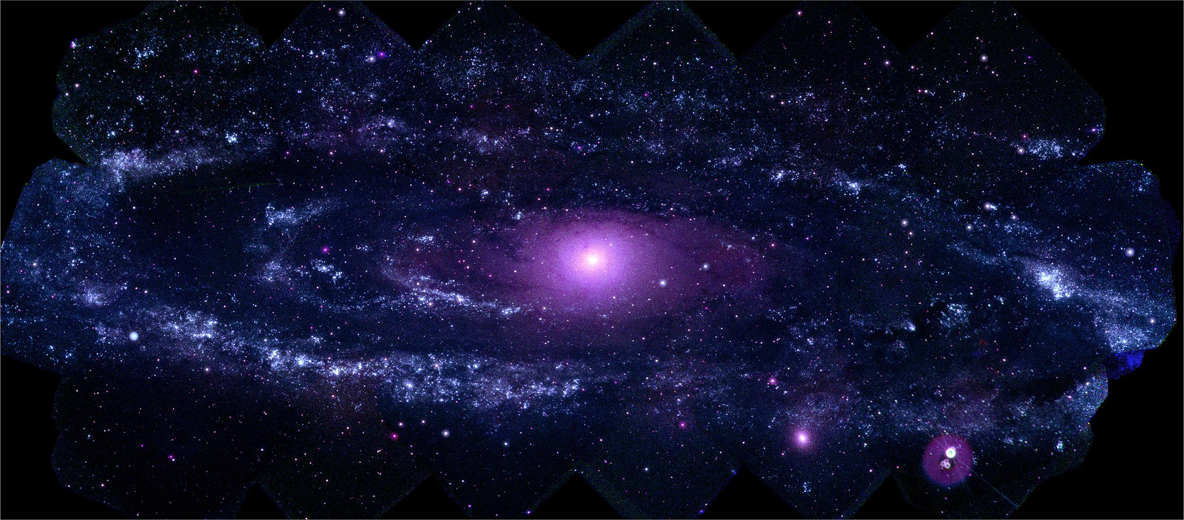
Physics is embedded Mathematics in Nature
Notes:
What is the math/physics of learning
Physics is embedded Mathematics in Nature

Slide 14
Strengths of generalized calculus in differential geometry:
Differential geometry offers a framework for coordinate-free calculus:
Intrinsic calculus is unbiased by representations with consistent changes of (local) coordinate systems
Covariant derivative ∇ generalizes ordinary derivative:
Coderivative of a tensor field by a vector field ∇_{V}T
Exterior derivative d generalizes ordinary differentials on differential forms ω :
Generalize integration on manifolds with Stokes-Cartan theorem
Geometric/real Clifford algebra:
multivectors allowing division by vectors
Notes:
https://en.wikipedia.org/wiki/Generalized_Stokes_theorem
https://en.wikipedia.org/wiki/Geometric_algebra

Slide 15
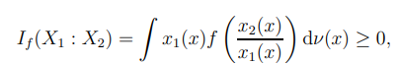
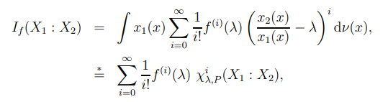
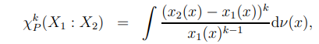
f-divergences as a series of signed 𝛘2-square type divergences
with

Slide 16
From niche research to hot engineering!
History of ANNs

Slide 17
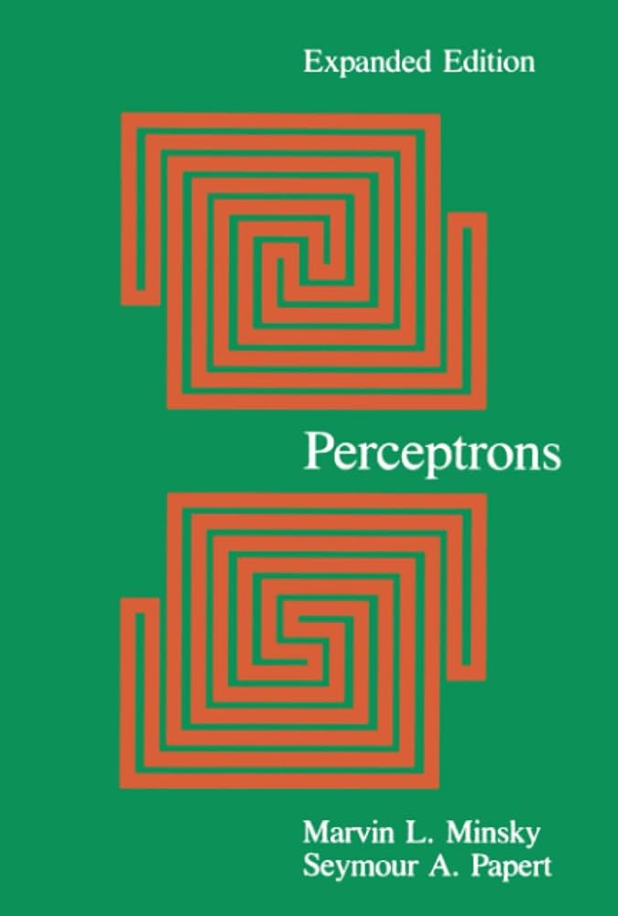
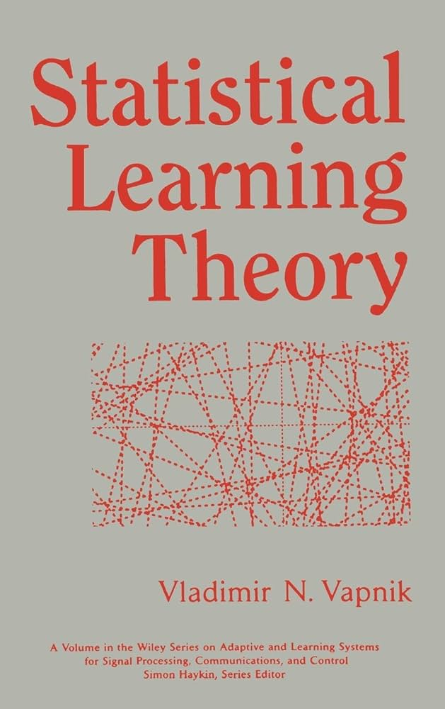



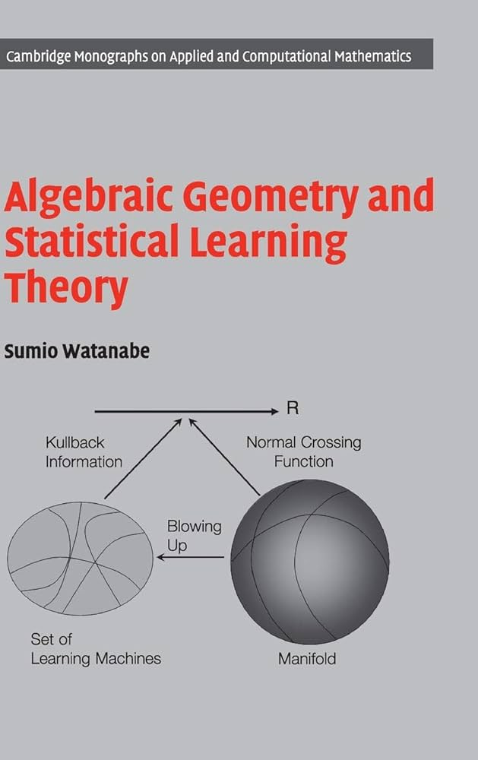
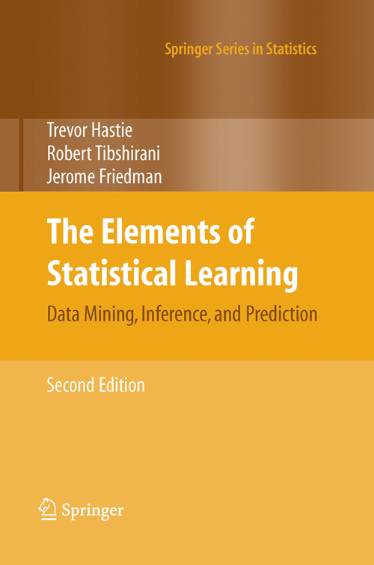
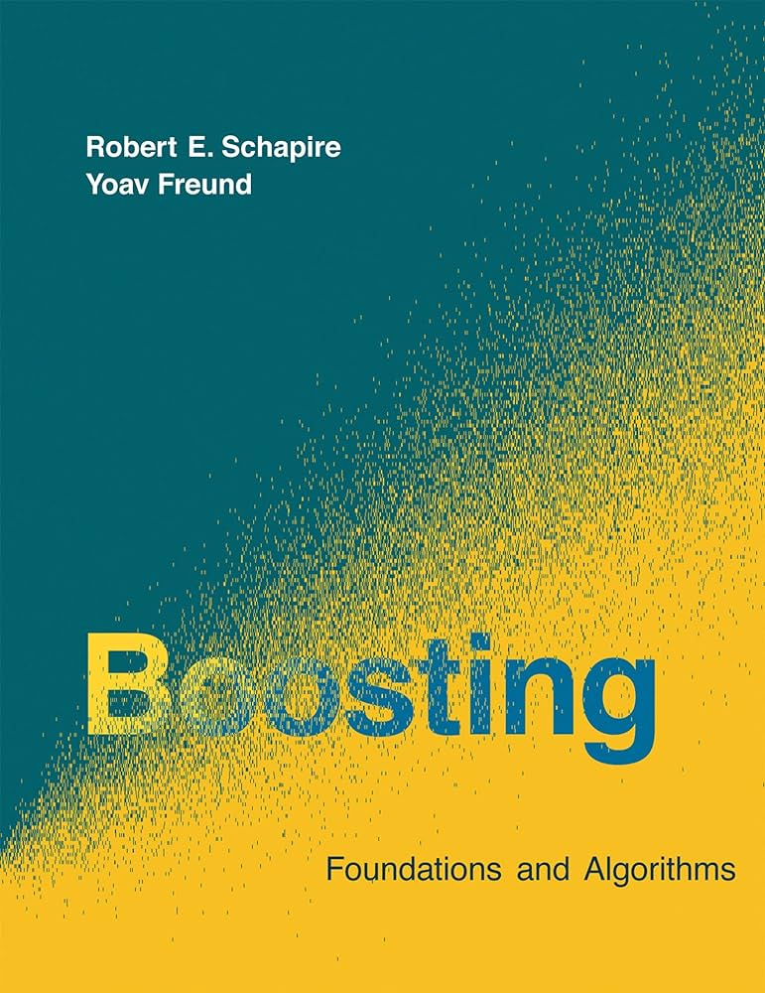

Notes:
Some masterpiece (text)books that shaped the field of Machine Learning

Slide 19

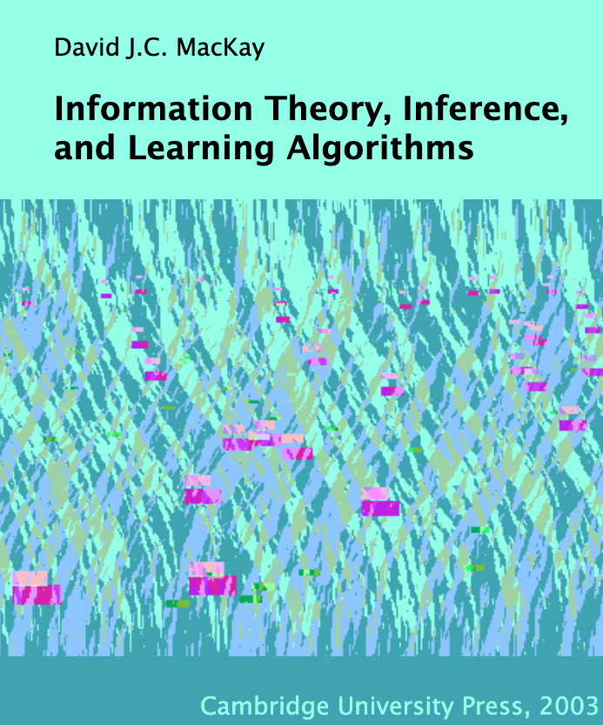

Slide 20

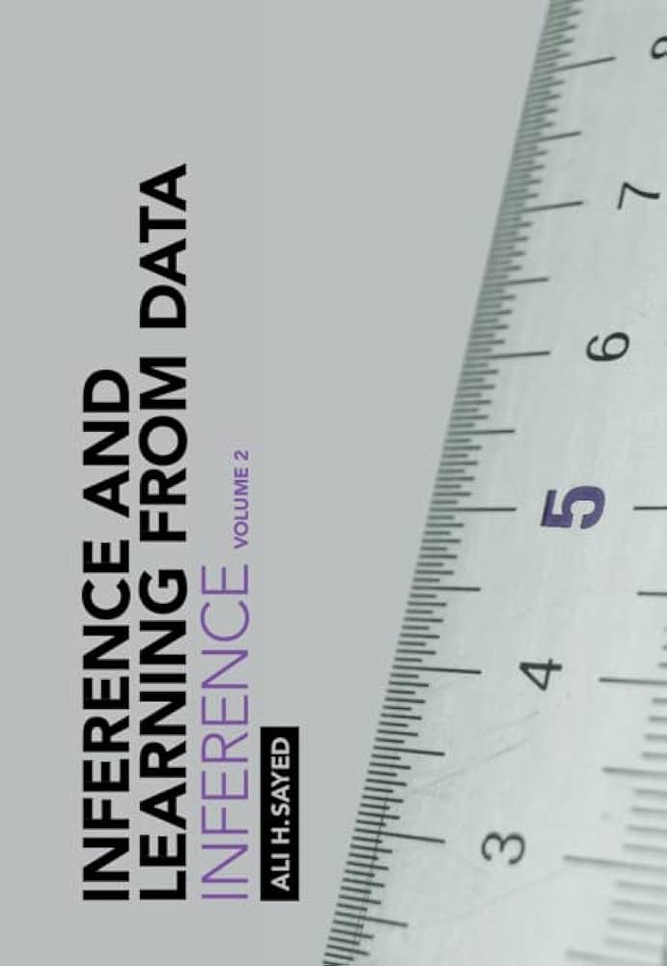

Notes:
Great trilogy books on machine learning by Prof. Ali Sayed (EPFL):
Foundations
Inference
Learning
https://tinyurl.com/TrilogyAliSayed

Slide 21
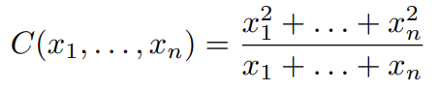
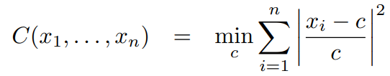
Contraharmonic or antiharmonic mean
Contraharmonic or antiharmonic mean of n positive reals:
The contraharmonic mean is the solution of the sum of the squares with relative errors:

Slide 22
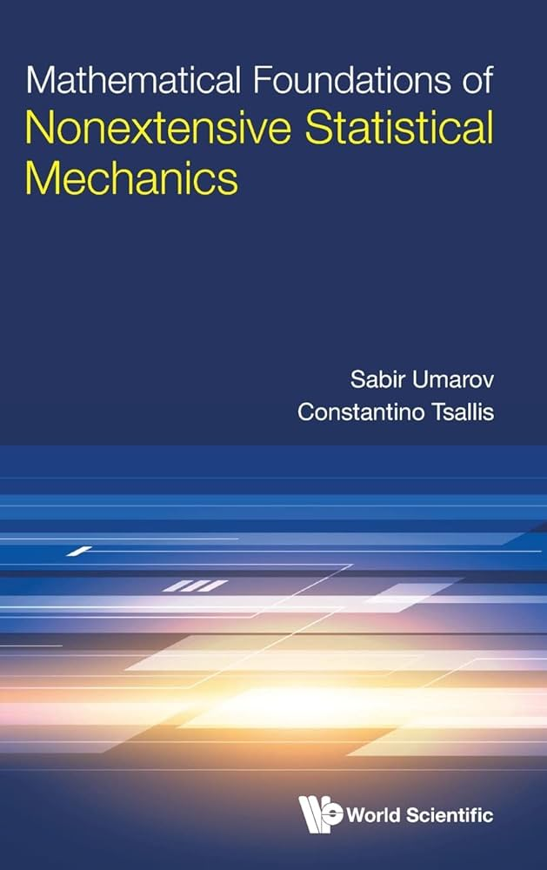
Andrej Karpathy

Slide 23

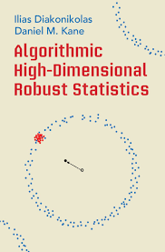




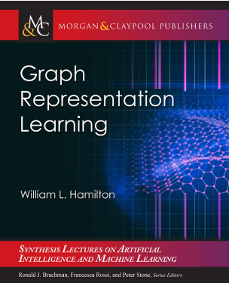

Slide 24


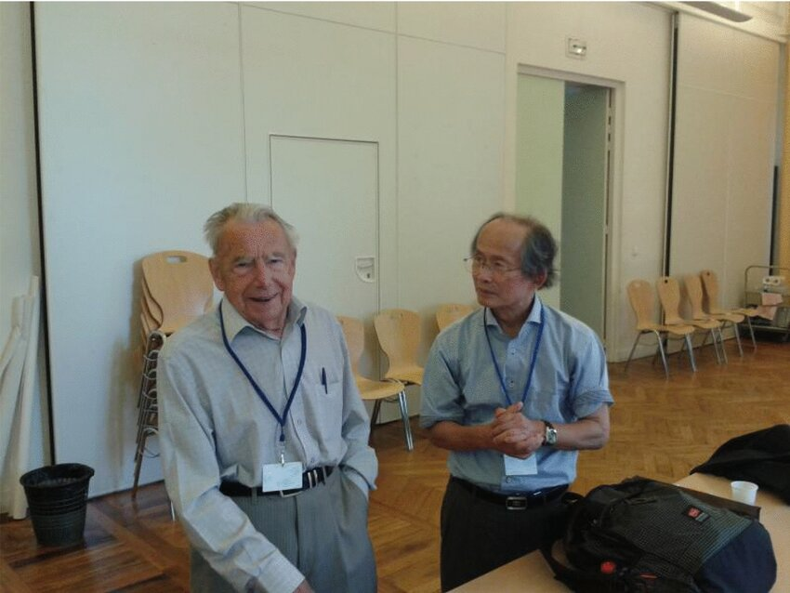
Hessian manifolds, Hessian geometry, Bregman geometry
Hessian structure on a manifold: (g, ∇) where g is a Hessian metric tensor and a torsion-free flat connection ∇
To every chart there is a potential function defining the Hessian metric in local coordinates of the chart
Hessian manifolds are special affine manifolds (M, ∇) where ∇ is a torsion-free flat connection
A Bregman divergence induces a Hessian manifold with a global chart, a Bregman manifold
Professor Jean-Louis Koszul (left)
Professor Hirohiko Shima (right)
at GSI 2013
志摩裕彦, へッセ幾何学， 裳華房， 2001
Shima, Hirohiko. The geometry of Hessian structures. World Scientific, 2007.
Tutorial on Bregman manifolds: "On geodesic triangles with right angles in a dually flat space." Progress in Information Geometry: Theory and Applications. Cham: Springer International Publishing, 2021. 153-190.
Notes:
Affine manifold (M, ∇): ∇ is a torsion-free flat connection
Hessian manifold : Affine manifold + Hessian metric tensor
Bregman manifold = Hessian manifold with global chart
Tutorial on Bregman manifolds:
https://tinyurl.com/HessBreg
https://twitter.com/FrnkNlsn/status/1712991125672518000
https://link.springer.com/chapter/10.1007/978-3-030-65459-7_7

Slide 25
Mathematics, proof, and computation
Mathematics can manipulate definite numbers (“mathematical entities”) as limits of computational processes. Shall computation be finite or how can we compute limits (halting problem, parallelism)?
For example: continued fractions, arithmetic-geometric means, etc.
Dualities in mathematics and computing: A program can be interpreted or solve many dual problems.
For example: cross product of two homogeneous 3D vectors interpreted as line passing through two points or dual intersection point of the corresponding two dual lines (here, projective geometry duality).

Slide 26
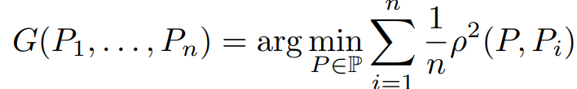
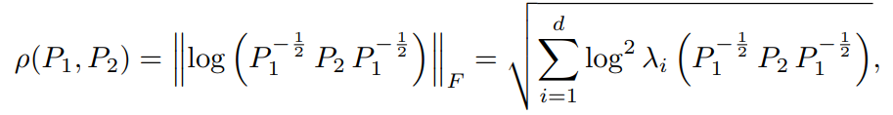
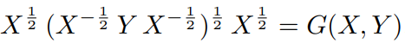
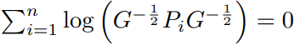
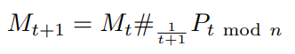
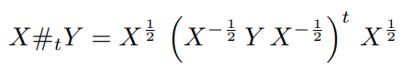


Geometric mean of n symmetric positive-definite matrices
Define the geometric mean of n SPD matrices as the unique minimizer of
When n=2: closed-form formula:
Unique solution is characterized by Karcher equation:
Simple inductive geometric mean: Let M₁=P₁ . Then iterate
In the limit, it converges to the geometric n-variable mean:
Extend to calculate expectations of SPD random variables with compact supports
with
with geodesic barycenter (weighted geometric bivariate mean):
What is... An inductive mean? AMS Notices, Dec. 2023
Notes:
Simple iterative algorithm to compute the geometric matrix mean of n SPD matrices.
Extend to approximate the expectations of SPD random variables with compact supports from variates:
https://franknielsen.github.io/MatrixGeometricMean/WhatIsInductiveMean-notformatted.pdf

